Slide 1
Lecture 9a
VLANs and WLANs

Slide 2
Virtual Networks
Virtual Network refers to
“ A class of service that uses a shared network infrastructure to emulate the characteristics of a private network
Virtual Networks can be implemented at several layers and different technology
WAN
MPLS, WDM – lightpath based VNs
Overlay Applications (P2P protocols)
Tunneling Protocols (GRE + IPSEC, PPTP, etc.)
LANs
Ethernet VLANs
Network “within” a network
Virtual LANs or VLANS: IEEE 802.1Q
Notes:
The virtual network should for all intensive purposes appear to the users as a fully functional physical network (``network within a network”).

Slide 3
Why VLANs?
Separate out users into logical groups of workers, regardless of actual physical location (security and QoS differentiation)
Help alleviate traffic congestion without adding more bandwidth – spreads out contention among different uses
Separate categories of traffic (VoIP separate from data)
Broadcast and multi-cast traffic only goes to members of VLAN
Security

Slide 4
VLANs are “Logical” LANs
Group of devices on one or more physical LAN’s that are configured such that they are logically attached to the same wire
May be located on different physical LAN segments
LAN’s based on LOGICAL instead of PHYSICAL connections
LAN membership defined by network manager
Preamble
Dest.
Address
Source
Address
VLAN Tag
Type
Body
FCS
Switches add and remove tags as necessary

Slide 5
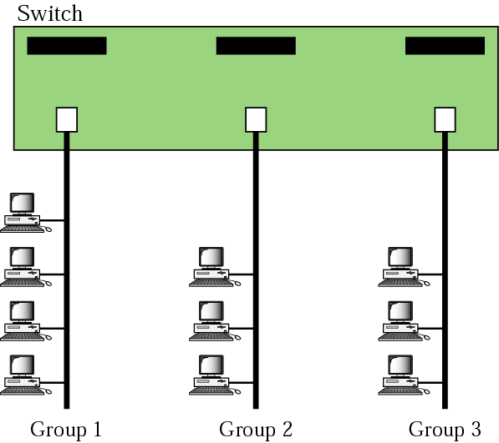
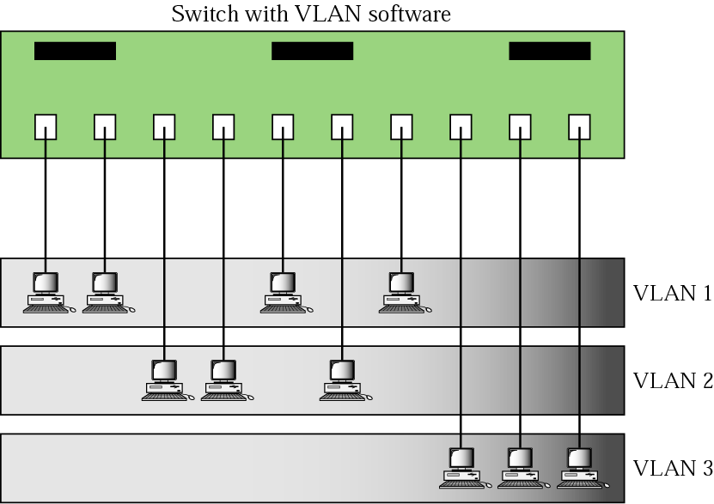
Physical LANs Vs Logical VLANs
A switch connecting three segments
A switch using VLAN software
Figure Source: Forouzan

Slide 6
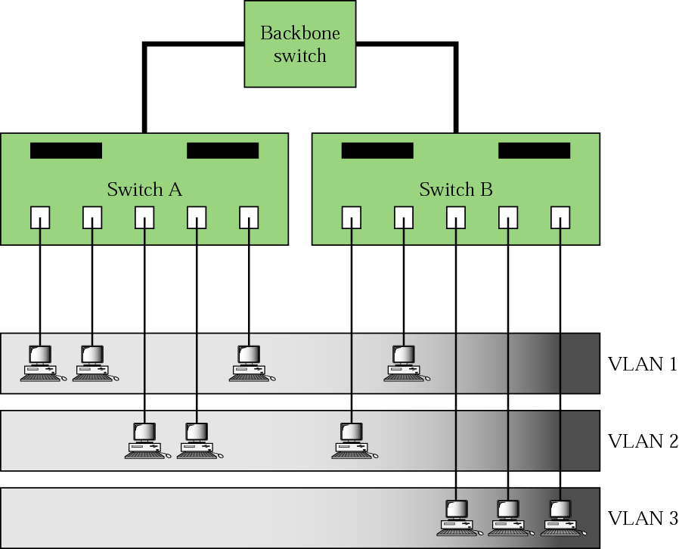
Hierarchical Possibilities
Figure Source: Forouzan
Two switches in a backbone using VLAN software

Slide 7
Wireless LANs (WiFi)
Still Local Area
Ubiquitous – WiFi
Others
HomeRF
HIPERLAN?
Bluetooth based WLANs
IR WLANs
Started as extensions to wired LANs
Still extensions to wired LANs, but increasingly stand-alone LAN solutions (especially in homes)

Slide 8
WLANs Summary
WLANs
Faster than 3G/4G
54 - 300 Mbps vs. 2 - 15 Mbps for 3G/4G when stationary
Data experience matches the Internet
Added convenience of mobility
Well established IEEE standards
Low cost, low barriers to entry.
Organizations can build own networks
Smaller range then cellular
Many operators deploying WLAN as adjunct to 3G/4G

Slide 9
Topologies
Infrastructure based (most popular)
Connect users to a wired infrastructure network
Wireless access network like cellular phone system
IEEE 802.11, a, b, g , n, ac, etc.
Ad-Hoc based networks
Provide peer to peer communication – mobiles communicate between each other directly
Rapid Deployment (conference room)
Bluetooth, IEEE 802.11, Zigbee/802.15.4, Proprietary
Point – to –Point (cable replacement)
Mesh

Slide 10
Wireless LAN Markets
Medical
Hospitals doctors and nurses have Tablets/PDA’s
Education
Universities/colleges have campus wide network
Manufacturing – factories, storage, etc.
Retail/Small Business
Superstores, grocery stores, Walmart, etc. use it for inventory management
Public Access (Hotels, airports, coffee shops)
(ATT/Google in U.S. coffee shops and bookstores, Wayport > 500 hotels, BT 5000 in U.K.)
Wireless ISPs in many cities and housing developments
Homes – mobility in and around house
Market over $4.8 billion in 2005 (*source researchmarkets)

Slide 11
Spectrum for Wireless LANS
Licensed Vs. Unlicensed
Private yard Vs. Public park
Industrial Scientific and Medical bands
902-928 MHz
2.4 – 2.4835 GHz
5.725 – 5.875 GHz
Unlicensed - National Information Infrastructure Bands (U-NII) bands (5-6 GHz) region
Three bands of 100 MHz each
Band 1: 5.15 - 5.25 GHz
Band 2: 5.25 - 5.35 GHz
Band 3: 5.725 - 5.825 GHz
18-19 GHz licensed available in U.S.
17 GHz, 40 GHz and 60 GHz under study

Slide 12
IEEE 802.11 Standard
The project was initiated in 1990
The first complete standard was released in 1997
Supports two topologies: Infrastructure and Ad hoc
Suite of standards for MAC layer and below
Main sub-standards IEEE 802.11, a, b, g, n, ac
Common MAC layer for all sub-standards
Supports different physical layers at various data rates and frequencies
Diffused infrared (802.11)
Frequency hopping and direct sequence spread spectrum (802.11)
Complementary Code Keying (802.11b)
Orthogonal Frequency Division Multiplexing (OFDM) (802.11a, g)
Multiple Input Multiple Output & OFDM (802.11n)
Is TDD for each physical layer
Many additional sub-standards studying various aspects

Slide 13
Some IEEE 802.11 Standards
Standard | Scope
802.11 | Original 1, 2 Mbps standard in 2.4 Ghz and IR frequency band
802.11a | 54Mbps physical layer in 5GHz band
802.11b | 11Mbps physical layer in 2.4GHz band
802.11d | Operation in additional regulatory domains
802.11e | Enhanced 802.11 Mac to support QoS in other standards (a,b,g,n)
802.11f | Inter-access point protocol (IAPP) to support roaming
802.11g | 54Mbps physical layer in 2.4GHz band
802.11i | Enhanced security
802.11n | > 100Mbps physical layer using MIMO techniques
802.11s | Mesh networking
802.11u | Interworking with other networks (e.g., cellular)
802.11v | Wireless network management
802.11ac | Operation under 6 GHz for extremely high throughput
802.11ad | Operation in 60 GHz bands for extremely high throughput

Slide 14
IEEE 802.11 Terminology
Access Point (AP)
Acts as a base station for the wireless LAN and is a bridge between the wireless and wired network
Basic Service Area (BSA)
The coverage area of one access point
Basic Service Set (BSS)
A set of stations controlled by one access point
Distribution system
The fixed (wired) infrastructure used to connect a set of BSS to create an extended service set (ESS)
Portal(s)
The logical point(s) at which non-802.11 packets enter an ESS

Slide 15
Infrastructure Network Topology
A wired infrastructure supports communications between mobile hosts (MHs) and between MHs and fixed hosts
Star topology
The BS or AP is the hub
Any communication from a MH to another has to be sent through the BS or AP
The AP manages user access to the network
APs typically mounted on wall or ceiling
AC power maybe a problem, power over Ethernet option delivers AC power over UTP Ethernet cable
Designed for multiple APs interconnected to cover larger areas to form ESS

Slide 16
Infrastructure based Architecture
Basic Service Set (BSS)
Members of the cell covered by one AP
Access Point (AP)
Basic Service Area (BSA)
a.k.a cell

Slide 17
Infrastructure-based Architecture
Portal
Extended Service Set (ESS)
Distribution System
AP₃
AP₁
AP₂
Extended Service Area (ESA): Disjoint or connected

Slide 18
Ad hoc network topology
Independent Basic Service Set (IBSS)
Distributed topology
MHs communicate between each other directly (like walkie-talkies)
No need for a wired infrastructure
Suitable for rapid deployment
Use in conference rooms
No support for multi-hop ad hoc networking - non standard freeware and proprietary systems available that support multi-hop

Slide 19
Protocol position of IEEE 802.11
fixed terminal
mobile terminal
server
infrastructure network
access point
application
application
TCP
TCP
IP
IP
LLC
LLC
LLC
802.11 MAC
802.11 MAC
802.3 MAC
802.3 MAC
802.11 PHY
802.11 PHY
802.3 PHY
802.3 PHY

Slide 20
The IEEE 802.11 MAC Layer
IEEE 802.11 is based on Carrier Sense Multiple Access with Collision Avoidance: CSMA/CA
Mandatory access mechanism is “asynchronous” based on CSMA/CA and is provided by what is called the Distributed Coordination Function (DCF)
Optional access mechanism for “time bounded” service is based on polling and is provided by what is called a Point Coordination Function (PCF)

Slide 21
More details of the 802.11 protocol stack
Note the various layers
PLCP = Physical layer convergence protocol
PMD = Physical medium dependent
PLCP adds its own header
Unlike Ethernet
LLC
Station Management
Data Link
Layer
MAC
MAC
Management
PLCP
PHY
Management
Physical
Layer
PMD

Slide 22
Physical and Virtual Carrier Sensing
The physical layer performs a “real” sensing of the air interface to determine if a medium is busy or idle
Analyzes detected packets
Detects carrier otherwise by RSS
The MAC layer performs a “virtual” carrier sensing
The “length” field is used to set a network allocation vector (NAV)
The NAV indicates the amount of time that must elapse before the medium can be expected to be free again
The channel will be sampled only after this time elapses (why?)
The channel is marked busy if either of the physical or virtual carrier sensing mechanisms indicate that the medium is busy

Slide 23
Idle Channel
DIFS
Data
Medium is idle
Medium is still idle
If the medium is idle, every MS has to wait for a period DIFS (DCF inter-frame spacing) to send DATA
After waiting for DIFS, if the medium is still idle, the MS can transmit its data frame

Slide 24
How does it help?
DIFS
Data
MS₁
DIFS
Medium is idle
Medium is still idle
MS₂
Medium is idle
Medium is not idle
If a second MS senses the medium to be idle after the first MS, it will find the medium to be busy after DIFS
It will not transmit => collision is avoided

Slide 25
Acknowledgements
DIFS
SIFS
Data
ACK
MS₁
Medium is idle
Medium is still idle
A short inter-frame spacing (SIFS) is used
SIFS is the absolute minimum duration that any MS should wait before transmitting anything
It is used ONLY for acknowledgements (which will be sent by a receiving MS or AP alone)
ACKs receive highest priority!
ACKs will almost always be sent on time

Slide 26
Data Transmission and ACKs
Medium is idle
DIFS
Medium is not idle
Data
Medium is idle
DIFS
SIFS
Medium is not idle
ACK
MS
AP

Slide 27
Busy Channel
DIFS
DIFS
Contention Window
Data
MS₁
Medium is idle
Medium is still idle
many MSs sense
channel to be idle here
Each MS has to still wait for a period of DIFS
Each MS chooses a random time of back-off within a contention window
Each MS decrements the back-off. Once the back-off value becomes zero, if the medium is idle, the MS can transmit
The MS with the smallest back-off time will get to transmit
All other MSs freeze their back-off timers that are “decremented” and start decrementing the timer in the next contention window from that point

Slide 28
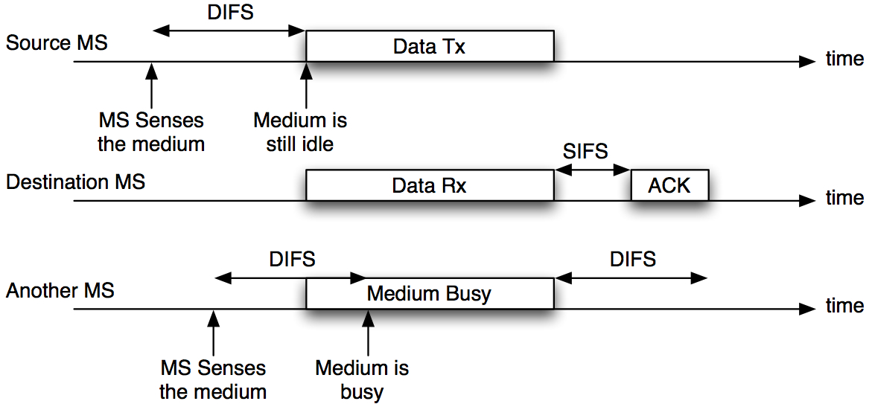
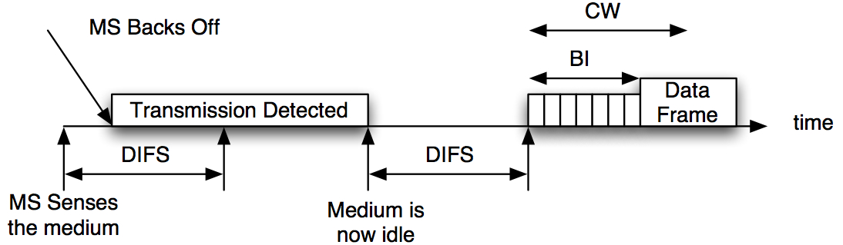
Summary

Slide 29
802.11 - Frame format
Types of messages in 802.11- control frames, management frames, data frames
Sequence numbers - important against duplicated frames due to lost ACKs
Addresses - receiver, transmitter (physical), BSS identifier, sender (logical)
Miscellaneous - sending time, checksum, frame control, data
bytes
2
2
6
6
6
2
6
0-2312
4
Frame
Control
Duration/
ID
Address
1
Address
2
Address
3
Sequence
Control
Address
4
Data
CRC
bits
2
2
4
1
1
1
1
1
1
1
1
Protocol
version
Type
Subtype
To
DS
From
DS
More
Frag
Retry
Power
Mgmt
More
Data
WEP
Order

Slide 30
Special Frames: ACK, RTS, CTS
Acknowledgement
Request To Send
Clear To Send
bytes
2
2
6
4
ACK
Frame
Control
Duration
Receiver
Address
CRC
bytes
2
2
6
6
4
RTS
Frame
Control
Duration
Receiver
Address
Transmitter
Address
CRC
bytes
2
2
6
4
CTS
Frame
Control
Duration
Receiver
Address
CRC

Slide 31
Beacon
Beacon
Beacon is a message that is transmitted quasi-periodically by the access point
It contains information such as the ESS-ID, timestamp (for synchronization), beacon interval, traffic indication map (for sleep mode), power management, AP capabilities, roaming support, security
Beacons are always transmitted at the expected beacon interval unless the medium is busy – in which they are the next transmission after an ACK
RSS measurements are made on the beacon message
Medium
Busy

Slide 32
Association and Disassociation
Association is procedure by which a MS “registers” with an AP
Only after association can a MS send packets through an AP
After powering up a mobile listens for Beacons in a passive scanning mode and attempts to associate with appropriate AP
A MS can be associated with only one AP
How the association information is maintained in the distribution system is NOT specified by the standard
The dissociation service is used to terminate an association
It may be invoked by either party to an association (AP/MS)
It is a notification and not a request. It cannot be refused
MSs leaving a BSS will send a dissociation message to the AP
Re-association – used for mobility – move from one BSS to another within ESS
Initiated by the MS

Slide 33

Mobility
Types
No Transition
MS is static or moving within a BSA
BSS Transition
The MS moves from one BSS to another within the same ESS (i.e., changes APs on the same network)
Re-association service is used when a MS moves from one BSS to another within the same ESS. It is always initiated by the MS with a Probe message
Probe: request from MS contains ESSID, Capabilities, Supported Rates
Probe Response: same as beacon except for TIM
After receiving probe response mobile picks new AP sends re-association request
Re-association Request: MS capability, listen interval, ESSID, supported rates, old AP address
Re-association Response: Capability, status code, station ID, supported rates
ESS Transition
The MS moves from one BSS to another BSS that is part of a new ESS
Upper layer connections may break (needs Mobile IP)

Slide 34
802.11 Physical Layer Options
Diffused infrared (802.11)
PPM , 1, 2 Mbps, ARQ with CRC, 10m range, cheap
Frequency hopping spread spectrum (802.11)
Random 2.5 hops per second, GMSK modulation, ARQ with CRC, 1, 2 Mbps in 915MHz band
Direct sequence spread spectrum (802.11)
11 bit spreading Barker code, DBPSK – 1Mbps, DQPSK – 2Mbps, ARQ with CRC, in 915MHz band
Complementary Code Keying (802.11b)
1,2, 5.5, 11 Mbps - spreading done in modulation channel symbols, error control ARQ with CRC in 20MHz band – 20MHz channels
Rate depends on RSS
Orthogonal Frequency Division Multiplexing (OFDM) (802.11a, g)
Parallel sub-channels with adaptive modulation based on SNR – higher data rates up to 54Mbps - 20MHz channels
OFDM and Multiple Input Multiple Output (802.11n)
Multiple antenna and receivers together with OFDM – higher data rates > 100Mbps

Slide 35
Example of PLCP Header
PLCP (always 1Mbps)
SYNC(128)
SFD (16)
Signal(8)
Service(8)
Length(16)
FCS(8)
MPDU
Preamble
Header
Note this is at 1 Mbps
Compare with Ethernet’s preamble
SYNC: Alternating 0,1s
SFD: 1111001110100000

Slide 36
802.11a,g
See http://en.wikipedia.org/wiki/IEEE_802.11n-2009 for 802.11n
OFDM: Each sub-carrier uses same modulation
There are 48 sub-carriers for data and 4 used as pilots
Data rate | Modulation | FEC Coding Rate | Data bits per channel symbol
6 Mbps | BPSK | 1/2 | 24
9 Mbps | BPSK | 3/4 | 36
12 Mbps | QPSK | 1/2 | 48
18 Mbps | QPSK | 3/4 | 72
24 Mbps | 16QAM | 1/2 | 96
36 Mbps | 16QAM | 3/4 | 144
48 Mbps | 64QAM | 2/3 | 192
54 Mbps | 64QAM | 3/4 | 216

Slide 37
802.11n
Approved a few years back- works in 2.4 and 5 GHz bands
4 to 5 times the data rates of 802.11a,g ➔ 200-300Mbps
Main Changes
Physical layer uses Multiple Input Multiple Output (MIMO) OFDM
Has multiple antennas at each end of the channel – provides spatial diversity
OFDM part about the same as 802.11a,g – uses 64QAM with 5/6 FEC rate
Channel Bonding
Combines 2 of the 20MHz 802.11a,g channels to achieve higher data rates
Packet Aggregation
Reduce overhead by aggregating multiple packets from a single application/user into a common frame

Slide 38
Other 802.11 standards in progress
802.11ac
Extremely high throughput in frequency bands below 6 GHz
Becoming the standard in most devices that are coming out today
802.11ad
Extremely high throughput in frequency bands 57-66 GHz
Also called WiGig
802.11af
TV White Spaces Operation

